Slide 1
Information coding in CA1 Hippocampus with an aversive-stimulus driven treadmill running task in head-fixed mice Samsoon Inayat, Brendan McAllister, Jianjun Sun, Bruce McNaughton, Majid Mohajerani
Sam Inayat
June 29, 2020

Slide 2
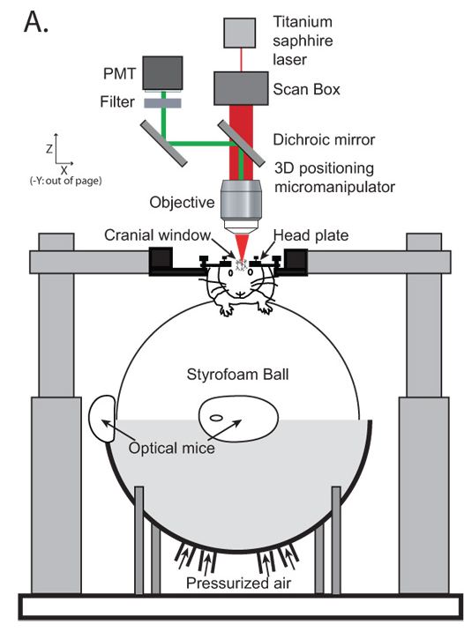
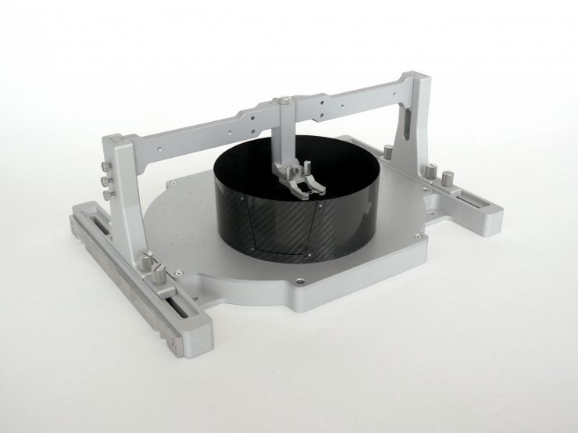
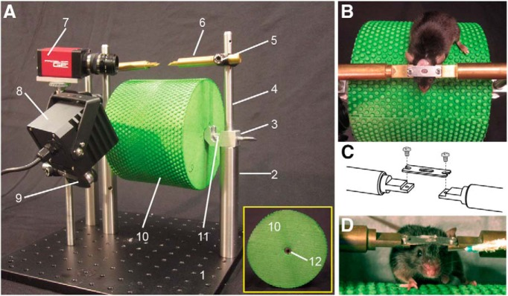
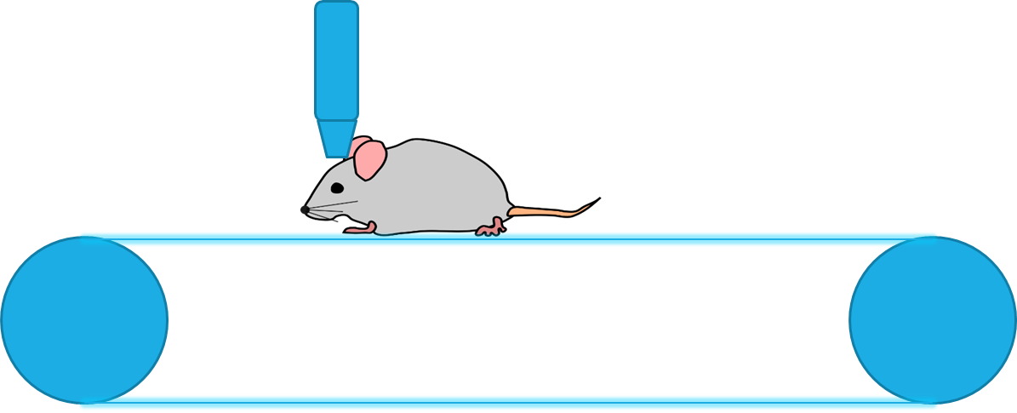
Current behavioral paradigms with head-fixed mice for finding spatially tuned cells
Two-dimensional movement
Running on a floating spherical ball
Visual stimuli presented using virtual reality
Tactile stimuli using ball with textured surface
Running on a floating 2D flat surface
One-dimensional movement
Running on a large cylinder
Running on a linear treadmill
https://www.neurotar.com/lataukset/whole-device-narrow-clamp.jpg
(Dombeck, Khabbaz et al. 2007)
Common to all paradigms → Motivation for running
Water deprivation of animals and operant conditioning with water rewards
Training takes 3weeks or more
(Heiney, Wohl et al. 2014)
Functional Imaging
Treadmill

Slide 3

Motivation for a novel behavioral paradigm based on aversive stimulus
Is it possible to train mice to run in response to an aversive stimulus?
Can we reduce training time using this paradigm compared to reward-based paradigm
What might be the conditions to train mice with an aversive stimulus such as air-puff?
Will we get spatially tuned cells if mice run on a treadmill in response to a continuous air-puff on a blank belt devoid of sensory cues?
Hypothesis was that since the air-puff onset is the only reference point which makes the animal move, cells will fire at fixed distances from there according to Path-Integration Theory.
Can we develop a behavioral protocol with this paradigm to test Path-Integration theory?

Slide 4
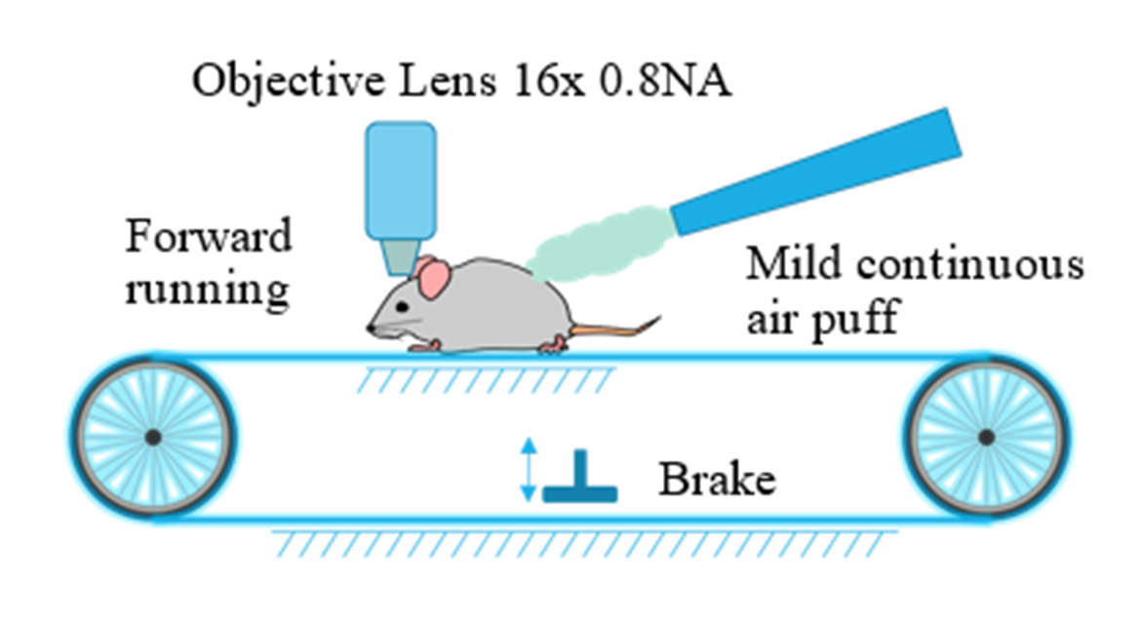
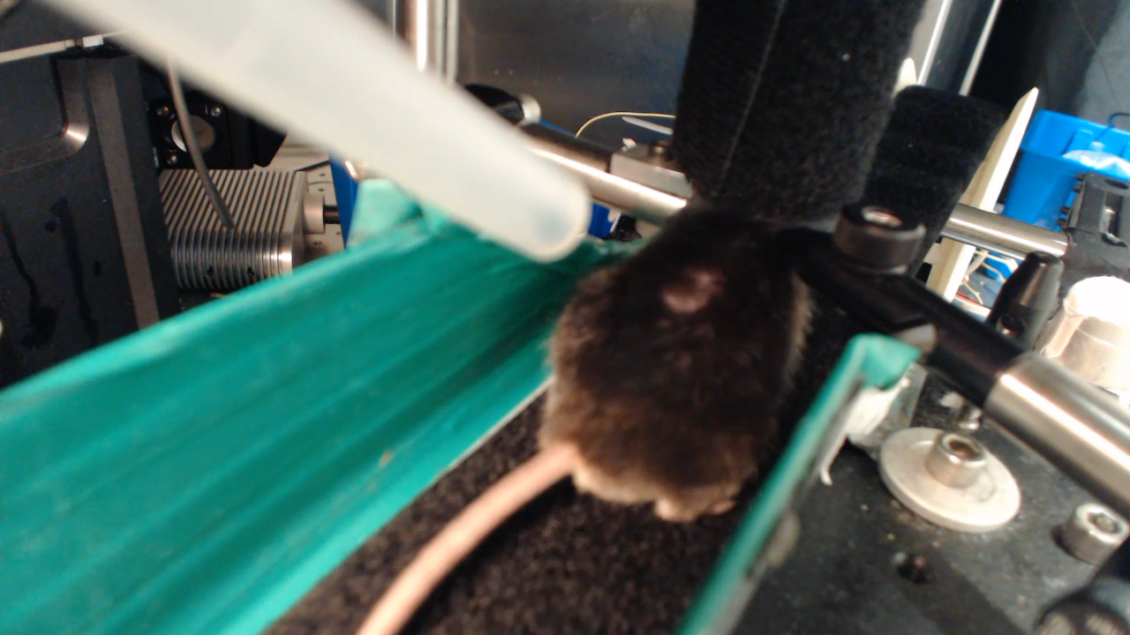
Novel behavioral paradigm Move and stop the animal at will
Motivation for running
Aversive stimulus and operant conditioning to run a desired fixed distance before the aversive stimulus would stop
Shorter training time expected compared to water reward based paradigm
Treadmill
Possible to create a mismatch between self-motion and sensory cues
Stopping the animal at will with a brake
Notes:
Two frames of references:
Air puff frame of reference
Belt frame of reference

Slide 5
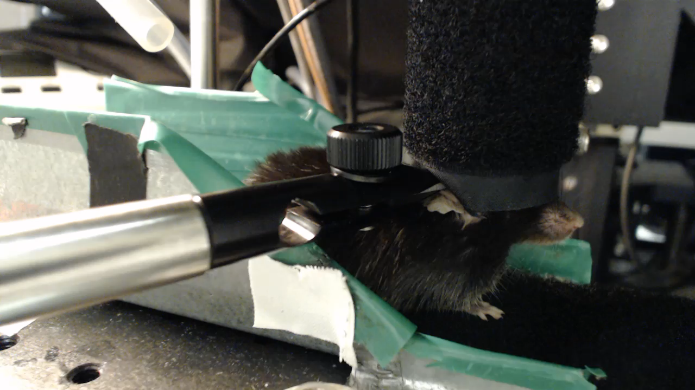
Behavioral training – make the animals run in response to the air puff
Animals have to run a fixed distance before the air puff would stop
Starting distance 30cm on day 1 and if in a trial the animal’s average speed is above 7 cm/sec then distance is increased by15 cm
Max time animals stay on the treadmill is ~25mins
Animals take 3-6 days to learn to traverse the whole belt ~142 cm with an average speed above 7 cm/sec

Slide 6
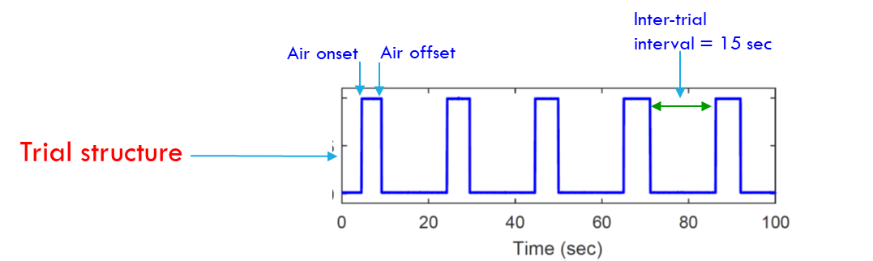
Trial structure for training and Two frames of references
Air puff frame of reference
Belt frame of reference
Intertrial-Period

Slide 7
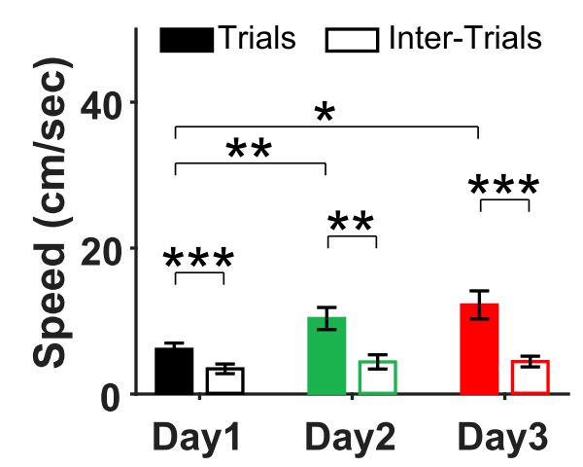
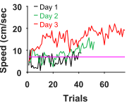
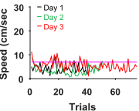
Results – speed →Air-puff Training
Repeated Measures ANOVA
N = 9
Trial Number
Inter-Trial Number

Slide 8

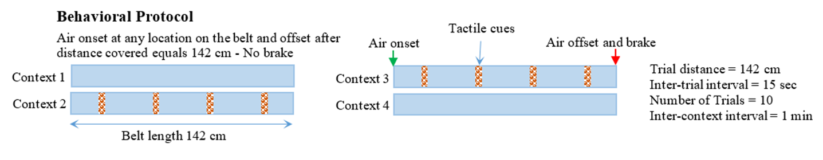
Testing protocol (different Belt conditions)
Presentation Sequence
10 trials
10 trials
10 trials
10 trials
Condition-1
1 minute gap to put cues on belt
Condition-2
1 min gap
Condition-3
1 min gap to remove cues from belt
Condition-4
Inter-trial
interval = 15 sec
Air onset
Air offset
Trial structure

Slide 9
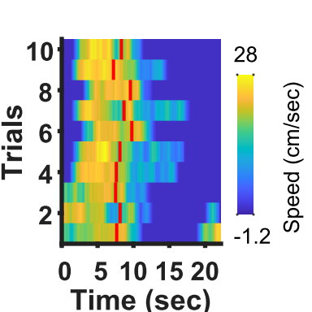
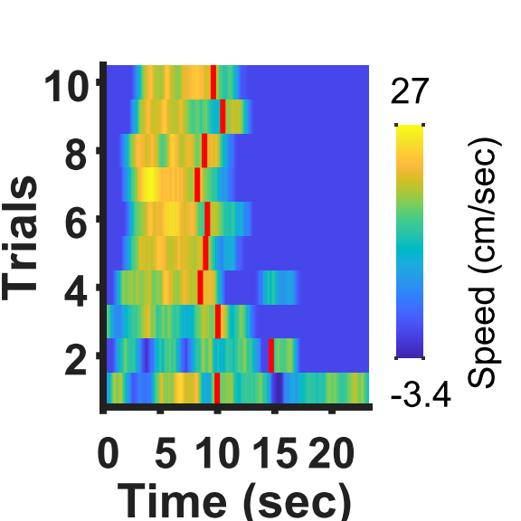
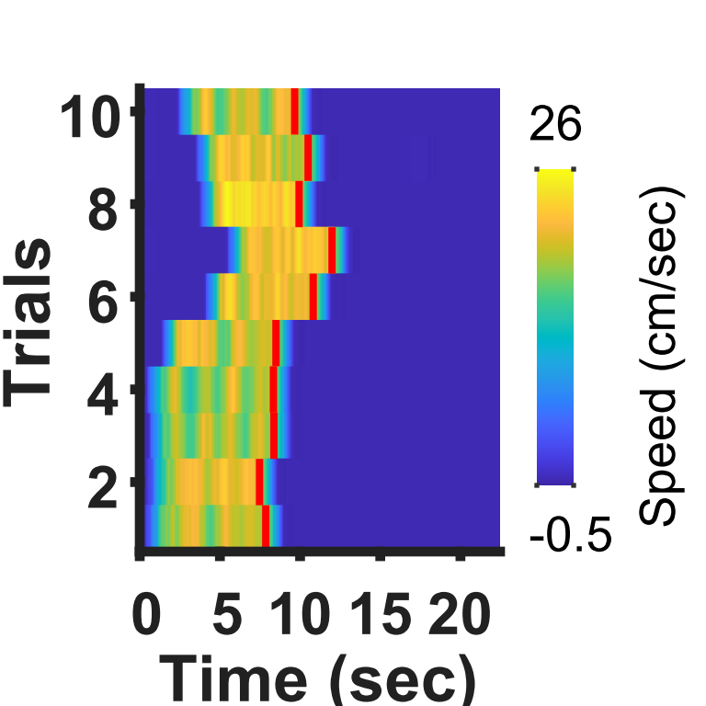
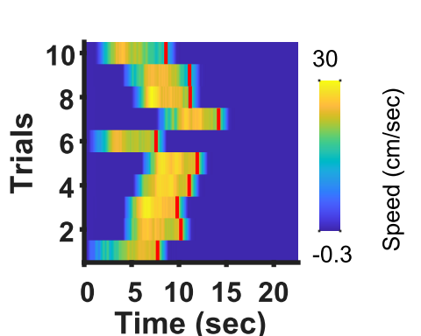
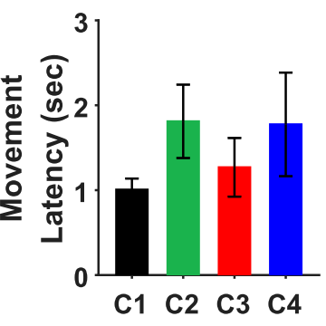
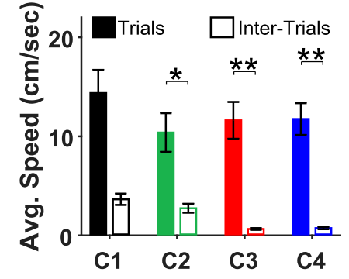
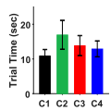
Results – testing with 4-conditions behavioral paradigm
Condition 1
Condition 2
Condition 3
Condition 4
Single Animal
Repeated Measures ANOVA (N = 5)

Slide 10
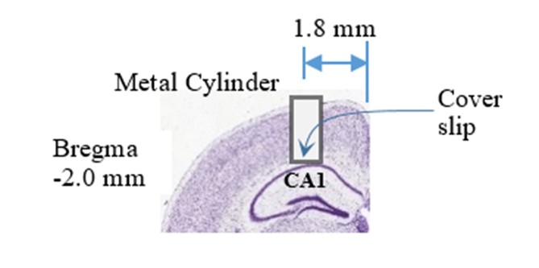
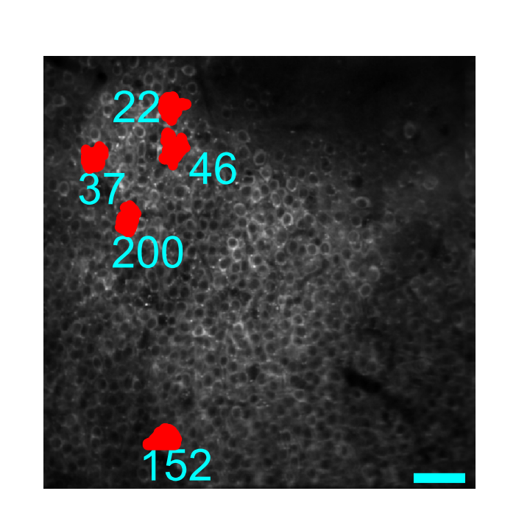
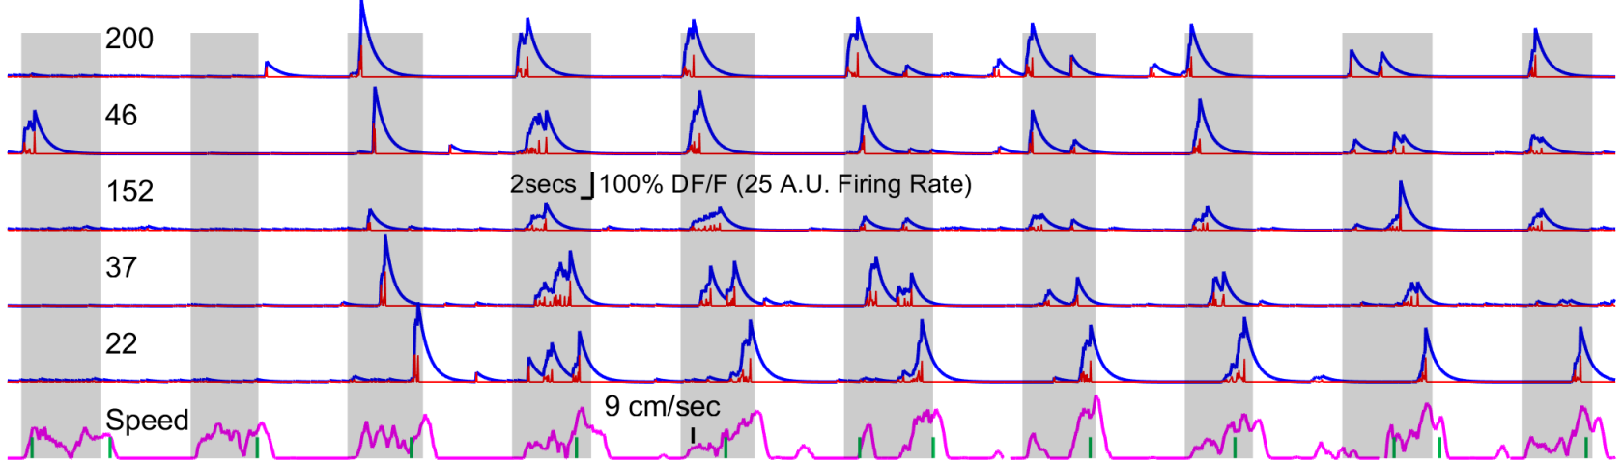
Results – Ca imaging
Depth
1st plane @ 125um
2nd plane @ 175um
Representative average image and calcium traces from Condition 1
Gray regions (air-puff trials), Calcium Signal (fitted), Deconvolved Spike Rate, Speed, Belt Lap Marker
Number of Cells (Suite2P)
Animal 1 = 532, Animal 2 = 601, Animal 3 = 704, Animal 4 = 487, Animal 5 = 350

Slide 11
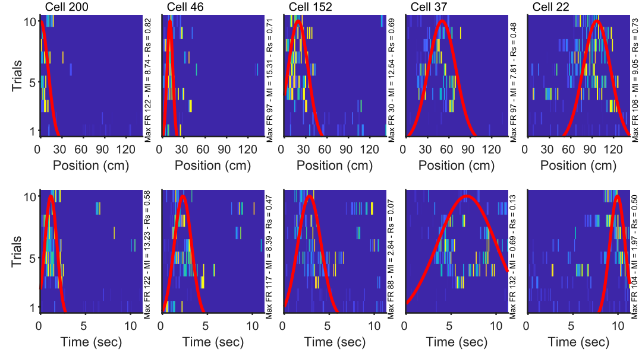
Results – raster plots (condition 1)
Representative
Air - Dist
Air - Time
Belt - Dist
AirI - Time

Slide 12

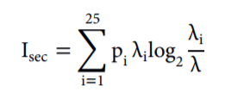
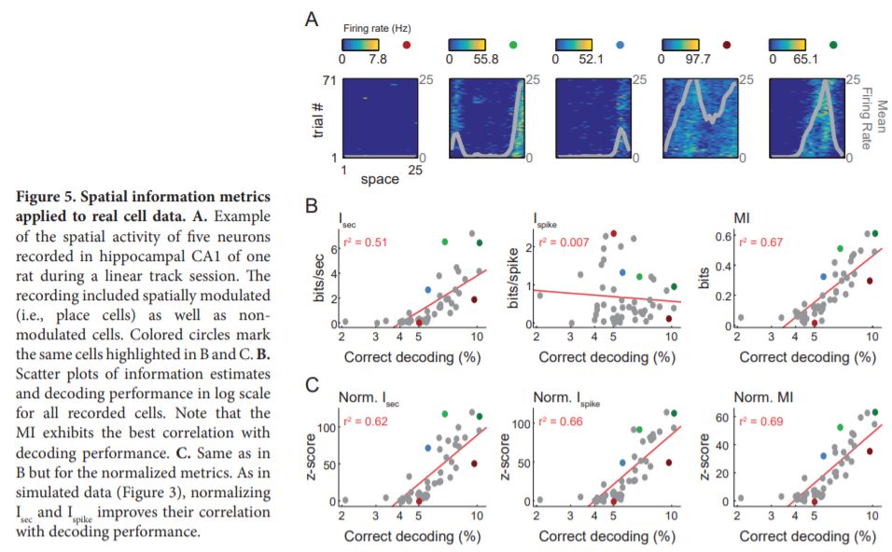
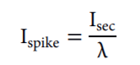
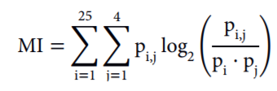
Mutual information z-score

Slide 13
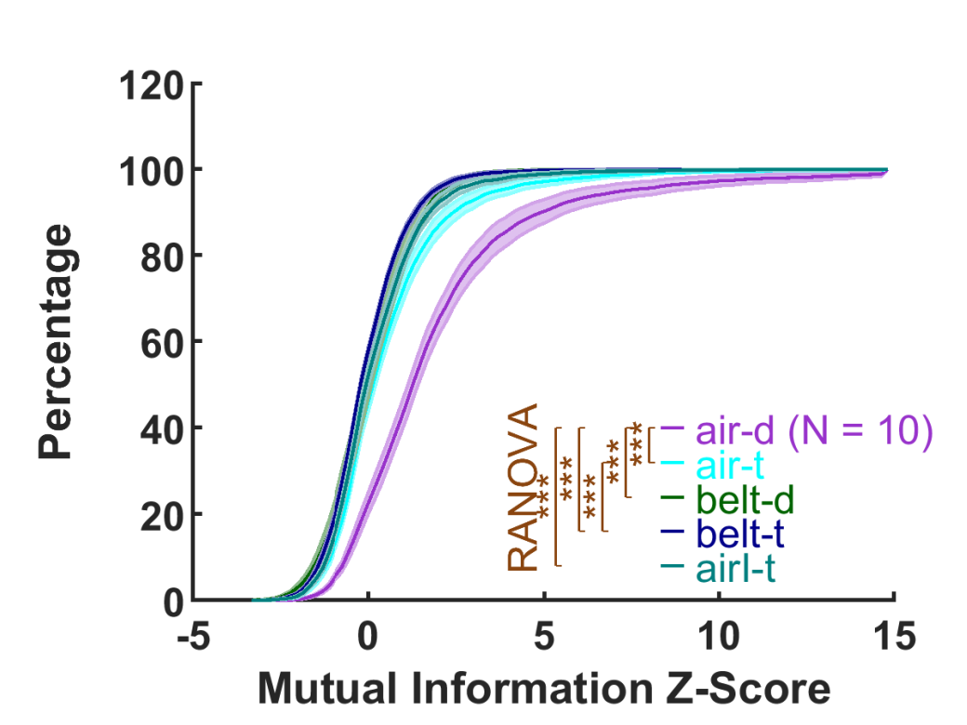
Average zMI distributions for condition 1 (all cells)

Slide 14
What criteria to classify cells into tuned vs untuned?

Slide 15
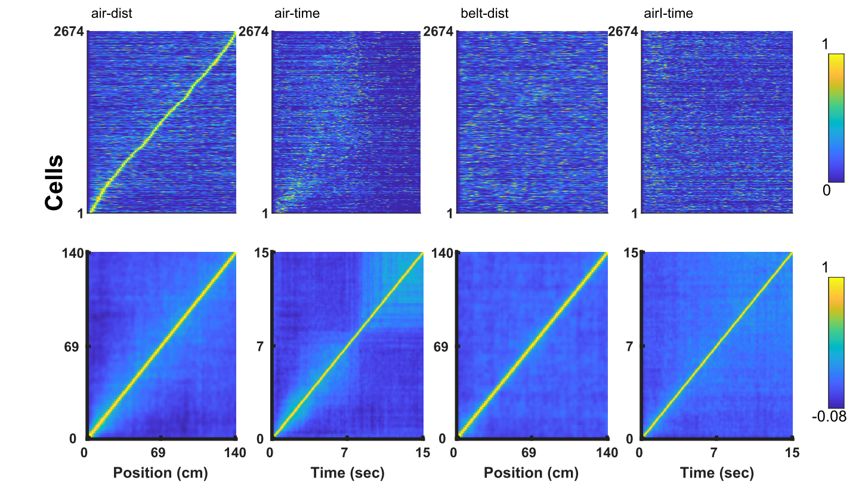
Population vector (cells pooled together)

Slide 16
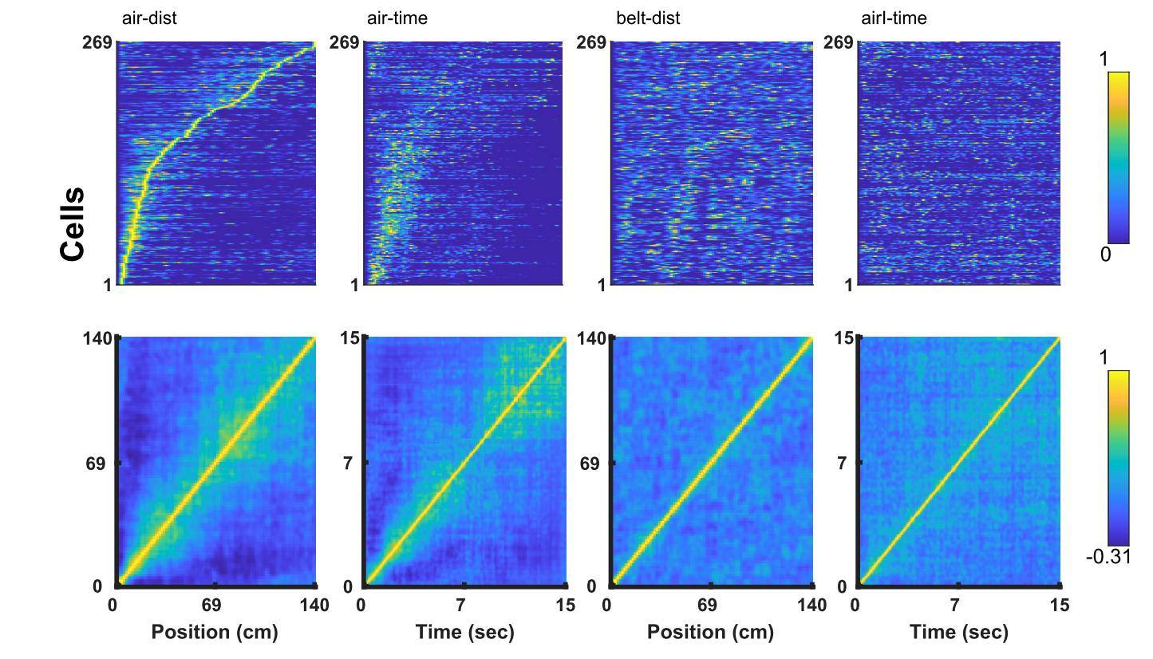
Population vectors (air-dist zMI > 5)
16.5414
18.4692
7.2443
1.0267
4.0000

Slide 17
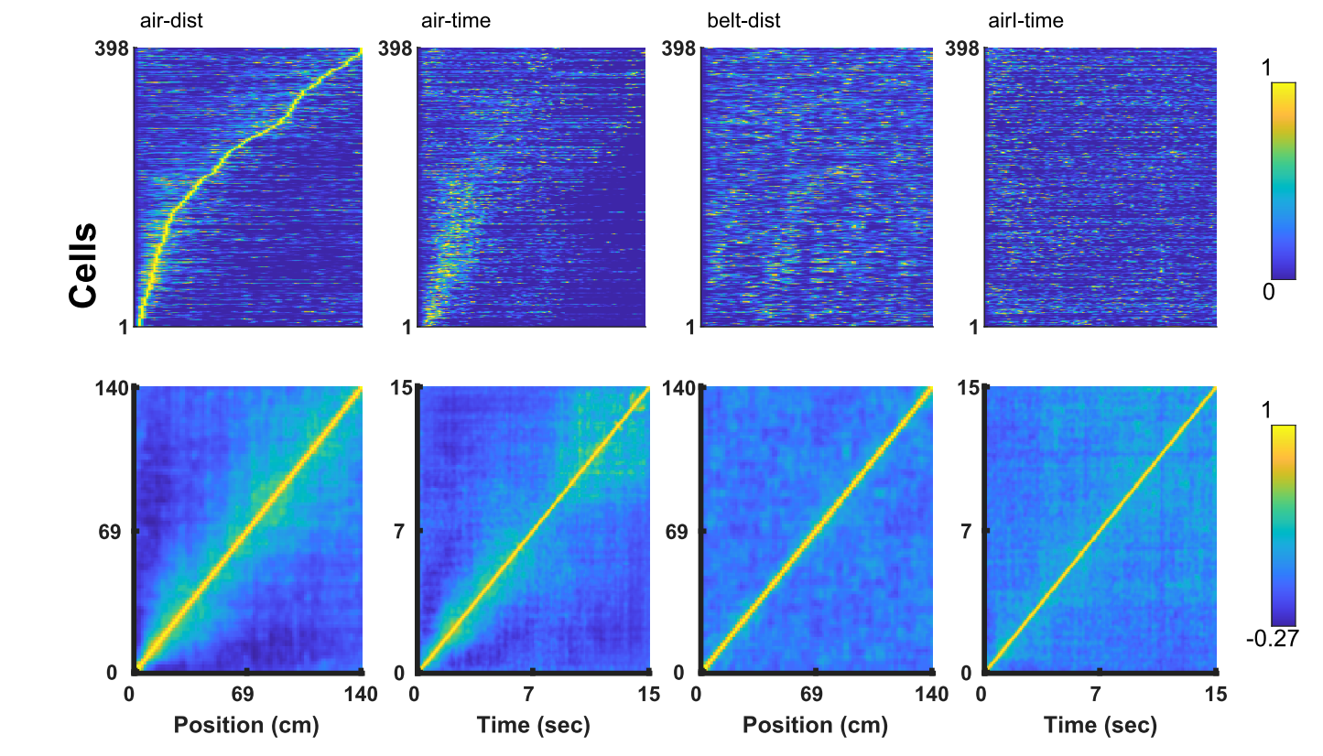
Population vectors (air-dist zMI > 4)
25.9398
24.2928
11.2216
2.0534
7.1429

Slide 18
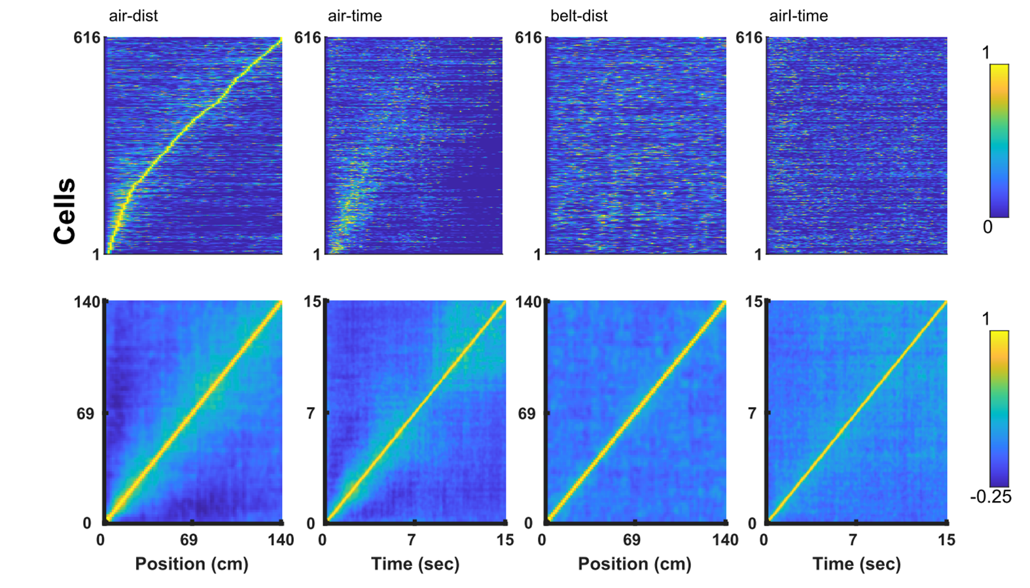
Population vectors (air-dist zMI > 3)
37.4060
34.1098
19.7443
4.5175
14.5714

Slide 19
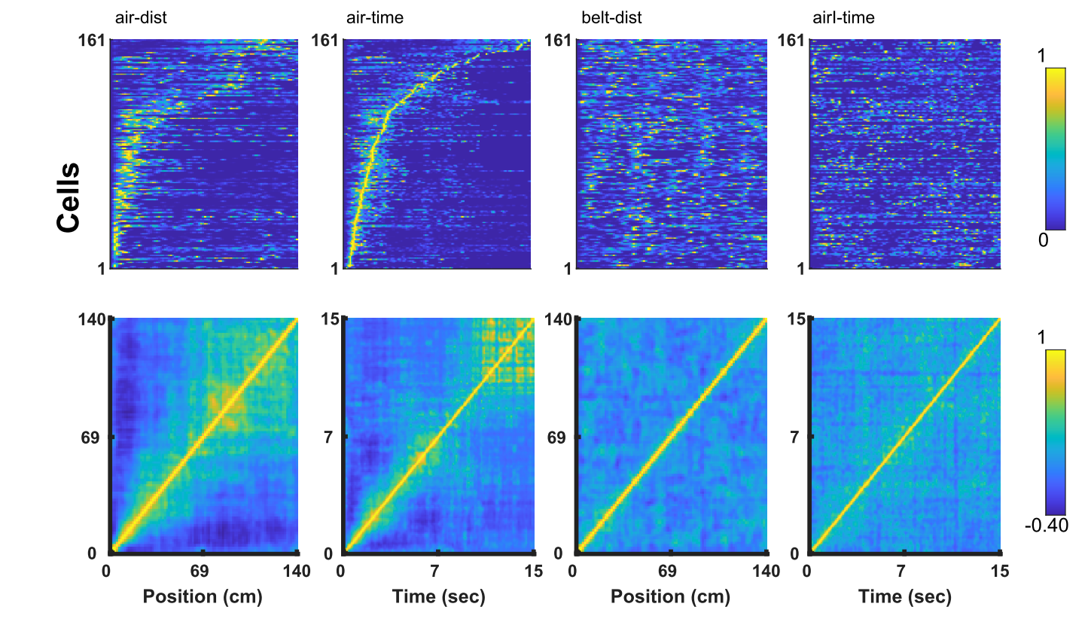
Population vectors (air-Time zMI > 3)
9.3985
4.6589
7.8125
3.9014
2.5714

Slide 20
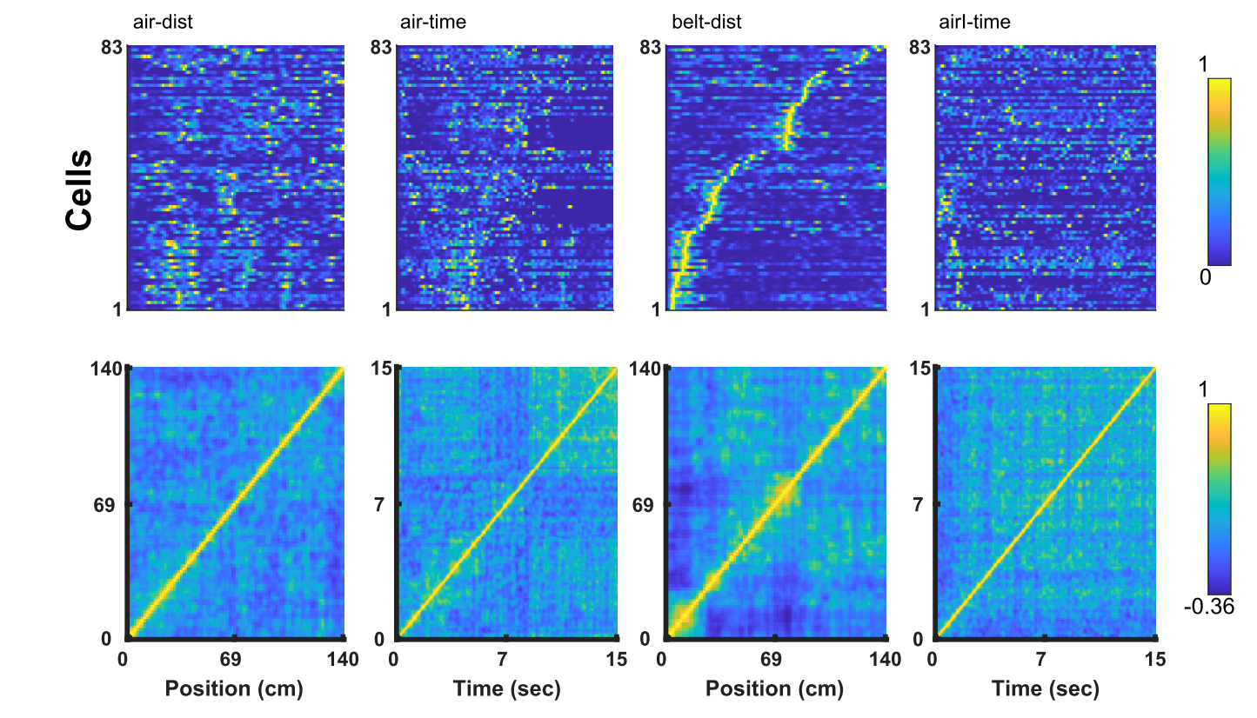
Population vectors (belt-dist zMI > 3)
0.7519
3.3278
2.6989
8.2136
0

Slide 21
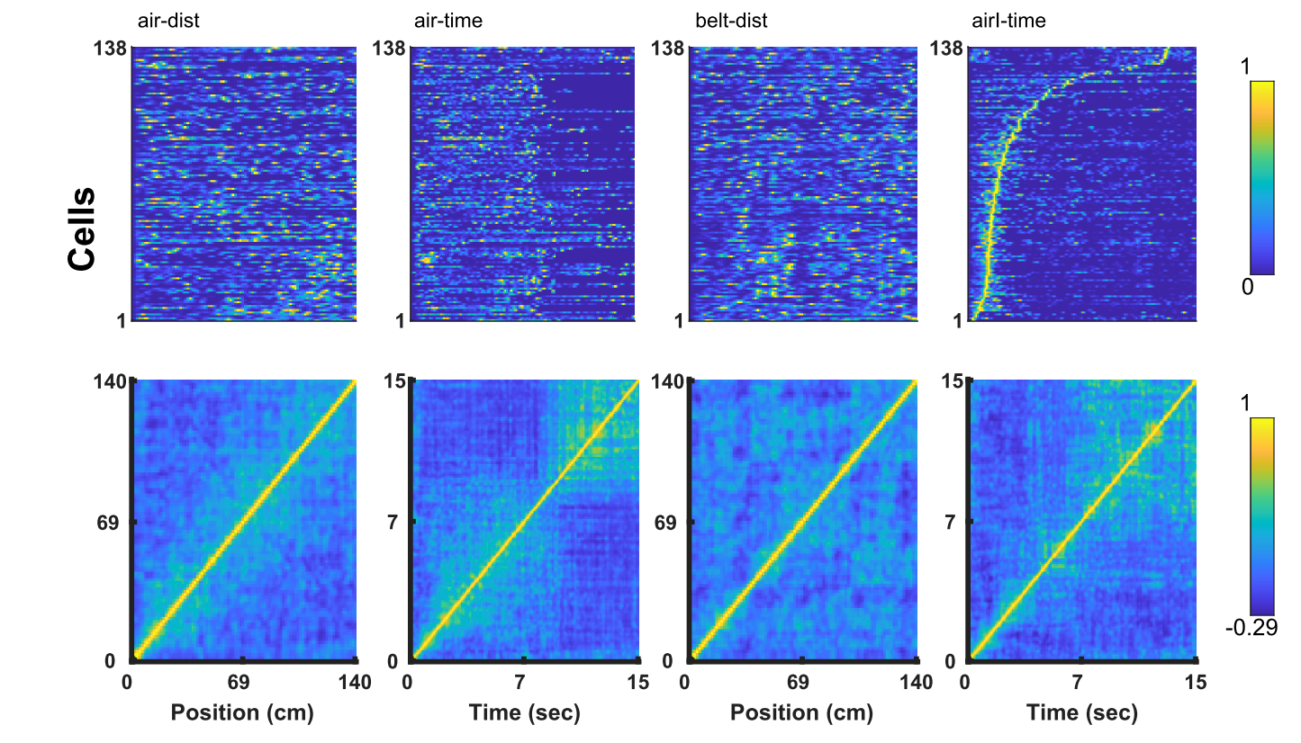
Population vectors (air-I-Time zMI > 3)
9.7744
9.6506
2.1307
1.6427
1.4286

Slide 22
Overlap between populations for condition 1
1 – Air – Dist
2 – Air – Time
3 – Belt – Dist
4 – Air I – Time

Slide 23
Interim conclusions
Is it possible to train mice to run in response to an aversive stimulus?
Can we reduce training time using this paradigm compared to reward-based paradigm
What might be the conditions to train mice with an aversive stimulus such as air-puff?
Will we get spatially tuned cells if mice run on a treadmill in response to a continuous air-puff on a blank belt devoid of sensory cues?
Hypothesis was that since the air-puff onset is the only reference point which makes the animal move, cells will fire at fixed distances from there according to Path-Integration Theory.
Can we develop a behavioral protocol with this paradigm to explore and test Path-Integration theory?

Slide 24
Interim conclusions
Mice can be trained to run continuously in response to continuous air puff
On average 3 days are sufficient to train animals to achieve speeds > 7 cm/sec. This time <<< what is required for reward-based paradigms
Spatially tuned cells – Cells encoding distance
Air Puff Frame of Reference – Distance from air-puff onset
Belt Frame of Reference – Distance from belt marker
Temporally Tuned Cells – Cells encoding interval ?
During trials as well as inter-trials
Temporally Tuned Cells are mostly close to air-puff onset or offset (have good distance encoding as well)

Slide 25
What would be the effect of addition and/or removal of sensory cues on the belt on spatial and temporal tuning?

Slide 26
Condition-1
Place/Time Cell
X
Path Integration input only
External Sensory Input
Internal Path Integration
Air Puff
Visual
Tactile
Auditory
Olfactory
Gustatory
Urination
Optic flow
Vestibular
Proprioception
Motion
Hypothesis: Place cell responses would be primarily driven by inputs from path integrators anchored to the air puff onset
Notes:
1) Presumably most place responses are driven by internal path integrators

Slide 27
Condition-2
Visuo-Tactile Cues
Place Cell
External Sensory Input
Internal Path Integration
Air Puff
Visual
Tactile
Auditory
Olfactory
Gustatory
Optic flow
Vestibular
Proprioception
Motion
Mismatch
in individual
Trials
(Inconsistent)
The addition of sensory cues will not markedly increase the number of place cells because sensory cues are not aligned with motion
Notes:
1) Single sensory input and see place cell responses? Presumable most place responses are driven by internal path integrators
2) We create a mismatch between external environment and internal path integration → we might see place cell firing
3) We can introduce sensory cues and see their effect

Slide 28
Condition-3
Air puff offset
Air puff onset
Brake
Place Cell
External Sensory Input
Internal Path Integration
Air Puff
Visual
Tactile
Auditory
Olfactory
Gustatory
Optic flow
Vestibular
Proprioception
Motion
Matching
in individual
Trials
(Consistent belt frame of reference)
A large number of place cells will emerge upon the alignment of sensory cues with motion

Slide 29
Condition-4
Air puff offset
Air puff onset
Brake
Place Cell
X
External Sensory Input
Internal Path Integration
Air Puff
Visual
Tactile
Auditory
Olfactory
Gustatory
Optic flow
Vestibular
Proprioception
Motion
Place cells will be primarily driven by path integration as there are no sensory cues on the belt. The number of place cells however will be larger than those in context 2 and context 1 because in the previous environment (Context 3) there was an elaborate sensory map and path integration was recruited.

Slide 30
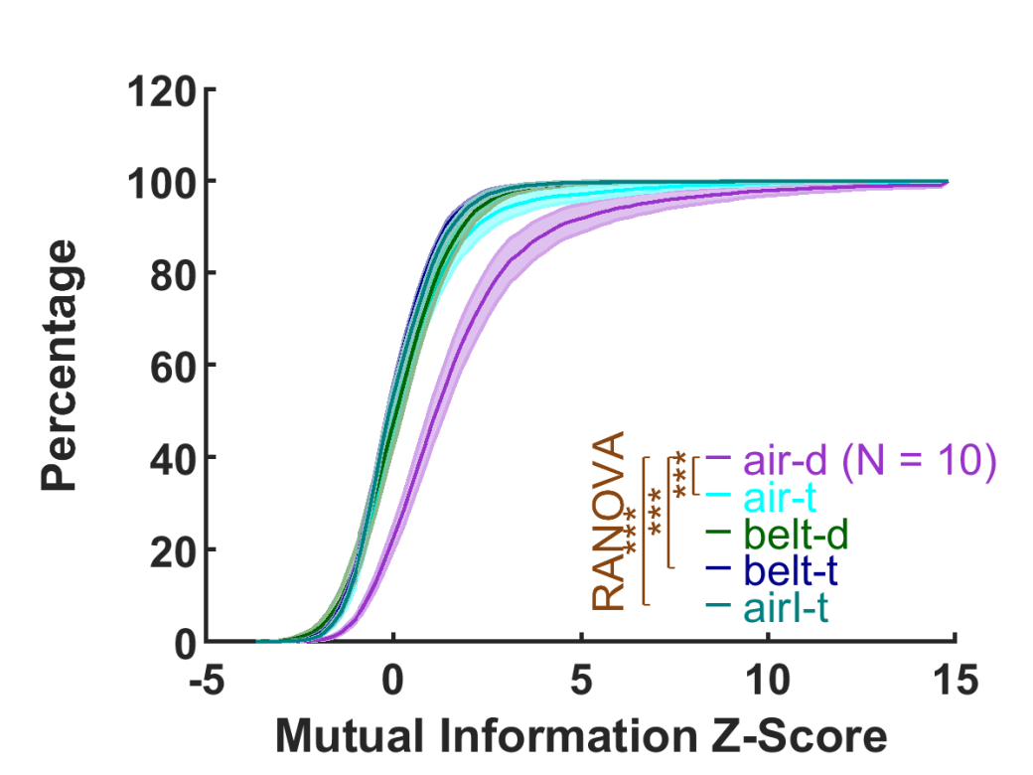
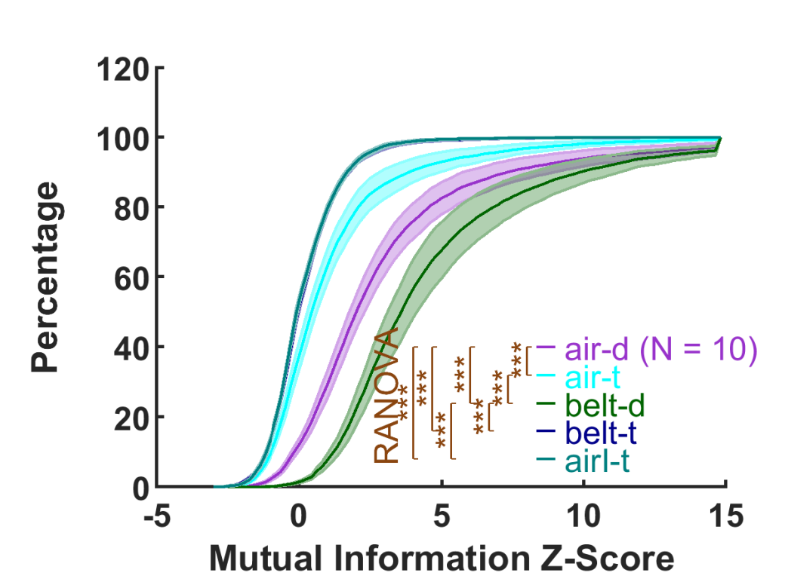
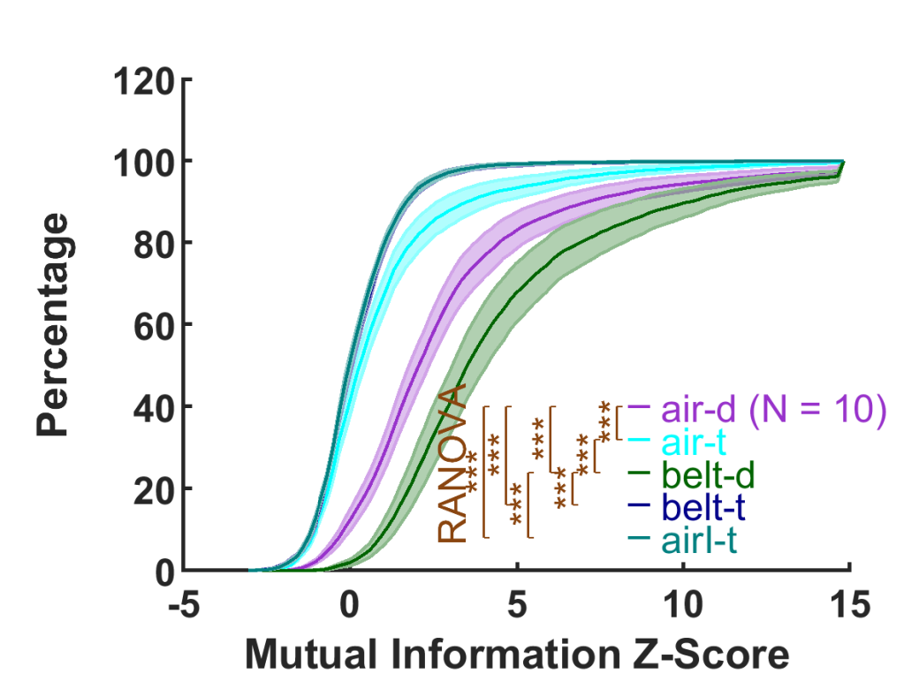
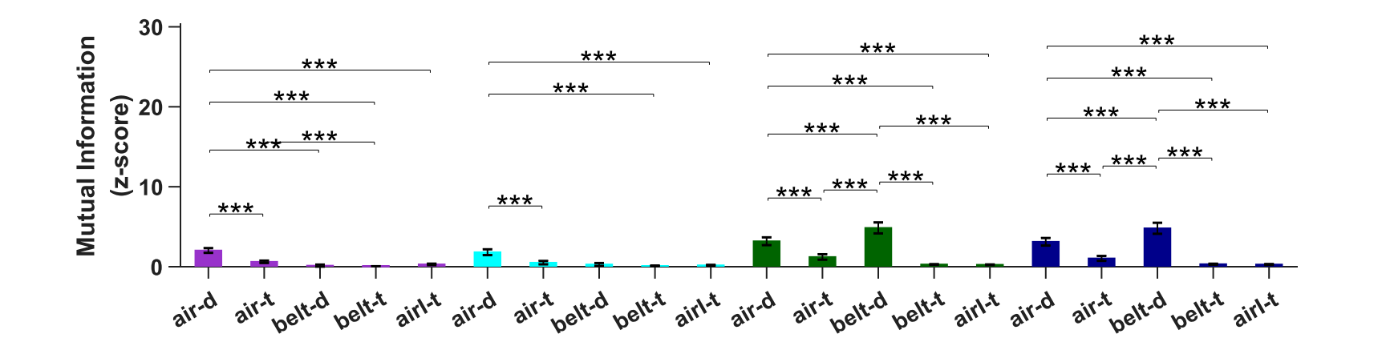
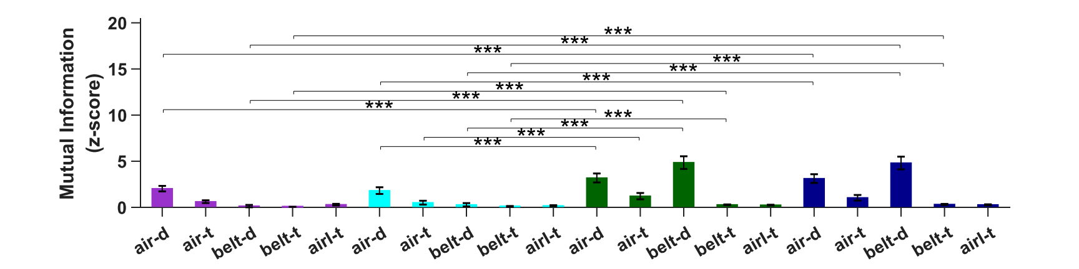
Results – distributions of mI – z-score – all cells
Condition 1
Condition 2
Condition 3
Condition 4
Repeated Measures ANOVA (N = 10)
Number of Cells (Suite2P)
Animal 1 = 532, Animal 2 = 601, Animal 3 = 704, Animal 4 = 487, Animal 5 = 350

Slide 31
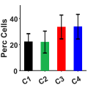
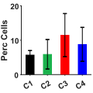
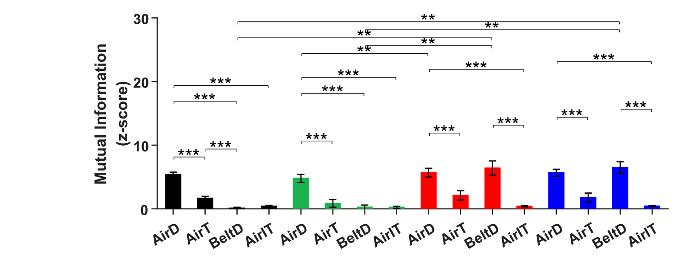
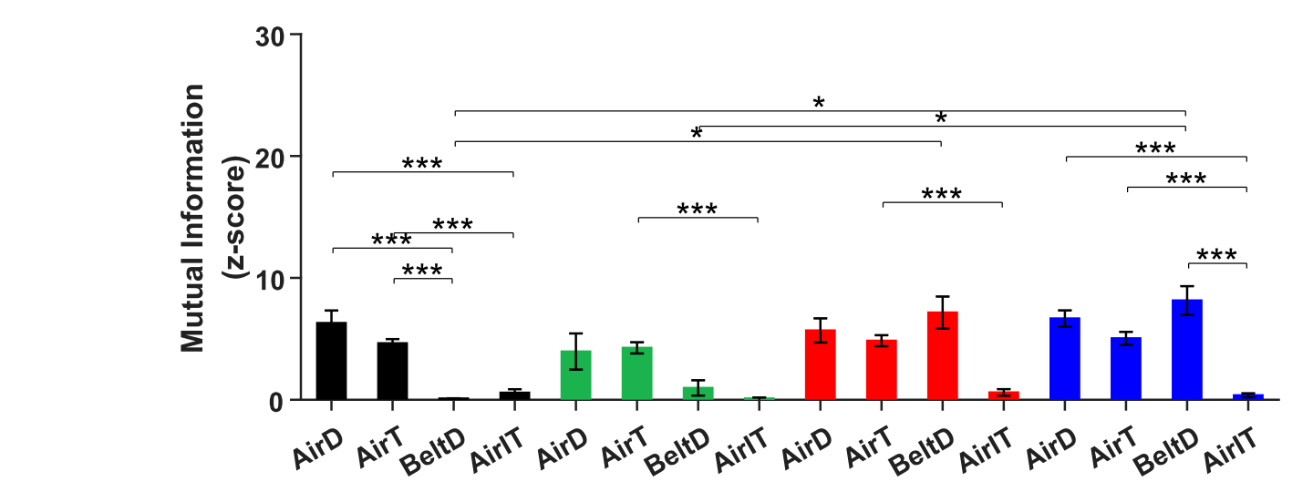
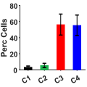
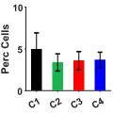
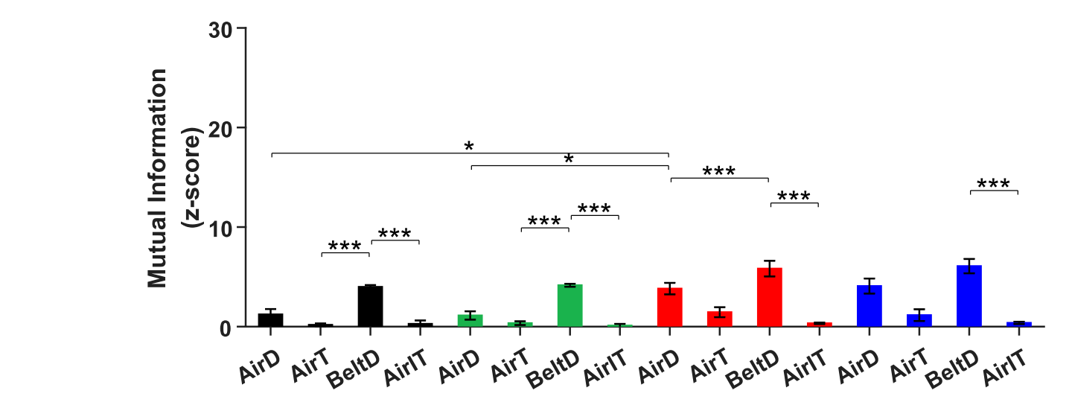
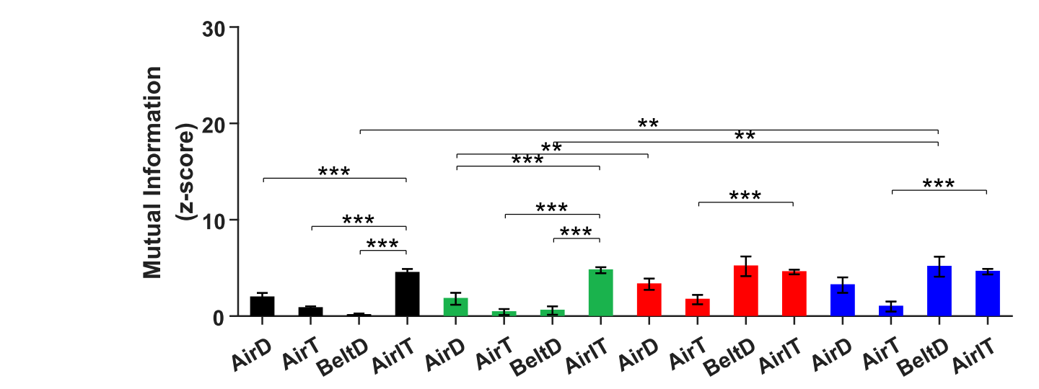
zMi comparisons for tuned cells
Repeated Measures ANOVA (N = 5)
zMI for AirD > 3
zMI for AirT > 3
zMI for BeltD > 3
zMI for AirIT > 3

Slide 32
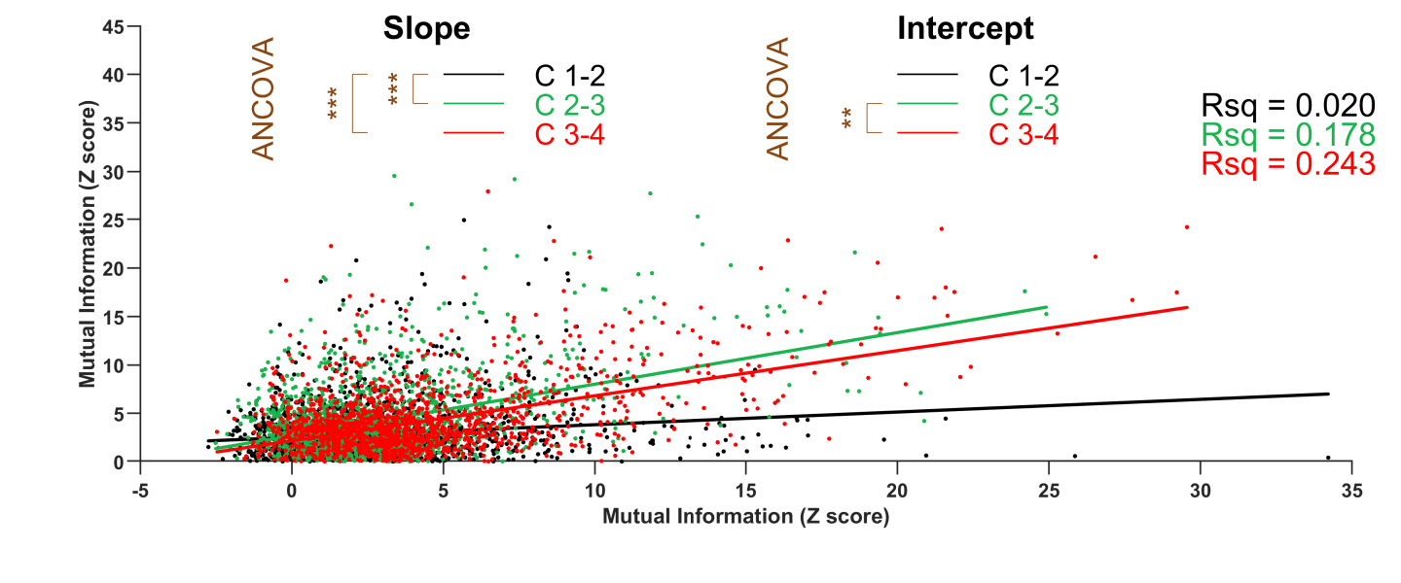
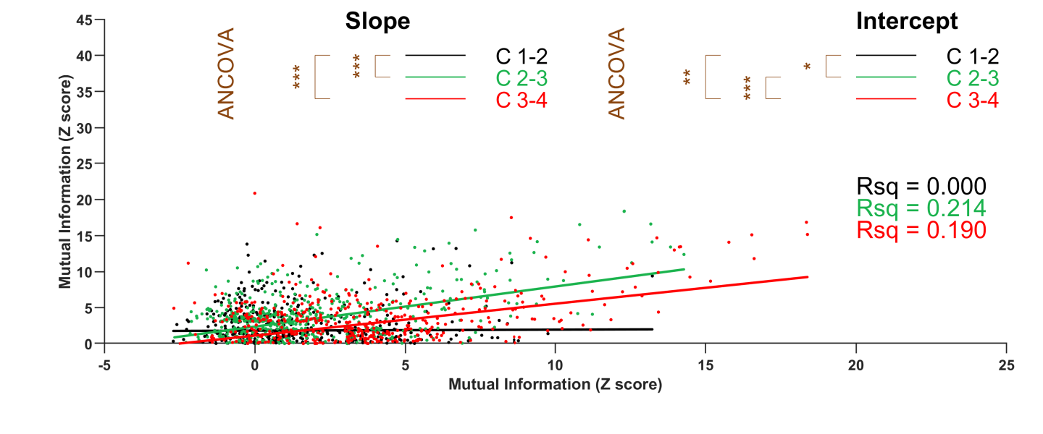


zMI change across conditions
zMI for AirD > 3
zMI for AirT > 3
zMI for BeltD > 3
zMI for AirIT > 3

Slide 33

Percentage of pcs
cellsOrNot = NaN; planeNumber = NaN; zMI_Th = 3; fwids = [0 140]; fcens = [0 140]; rs_th = 0.4;

Slide 34
Remapping air-dist cells from condition1 to condition2

